Slide 1

Client
Enrollment
Click to Begin

Slide 2
Error!
Please follow the on-screen
instructions to continue.
Go Back

Slide 3
Complete
Please navigate to the next module
in the course to continue.
Restart Course

Slide 4
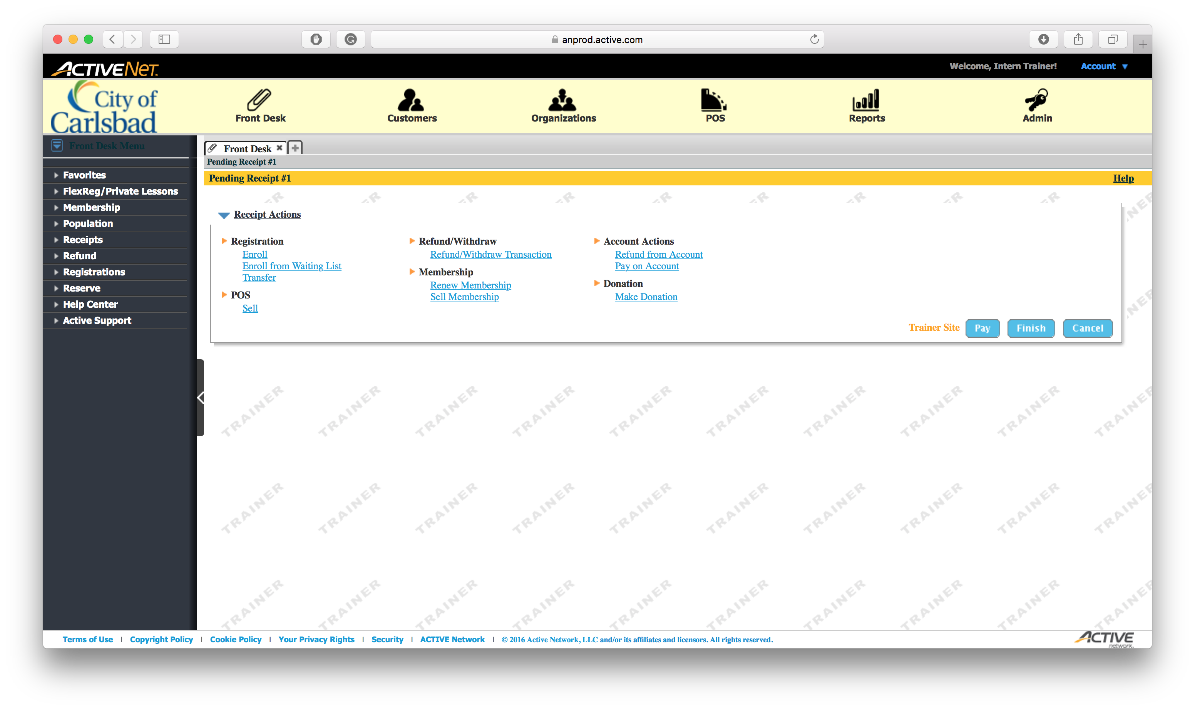
Tip:
Click Enroll

Slide 5
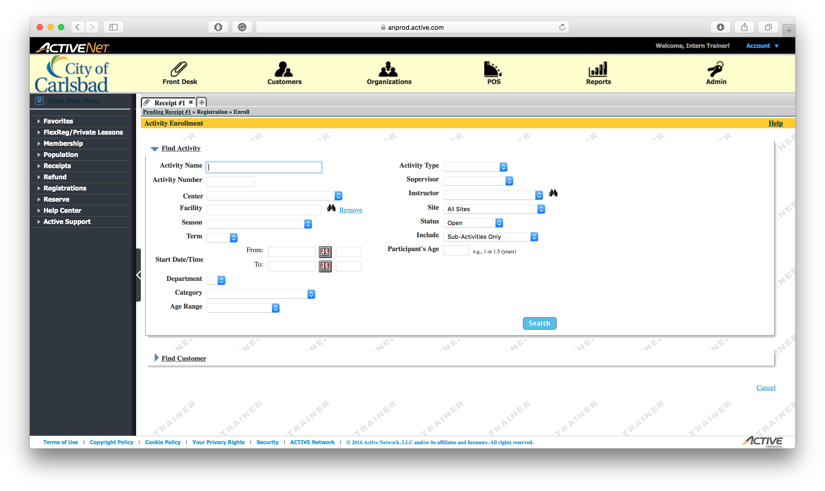
Tip:
Enter an Activity Name

Slide 6

Tip:
Click Search

Slide 7
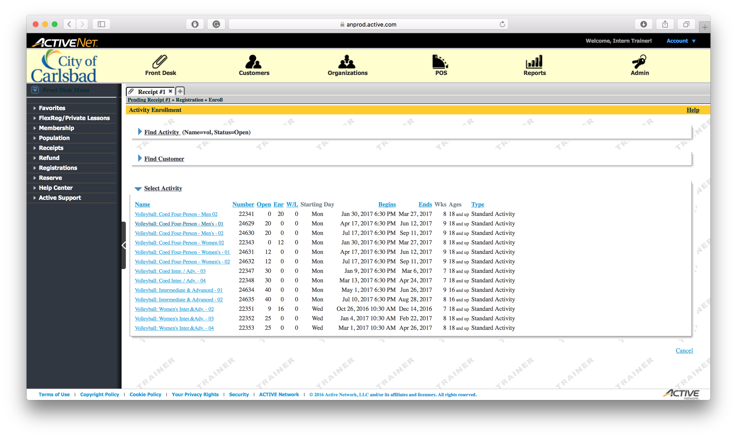
Tip:
Select Course #24629

Slide 8
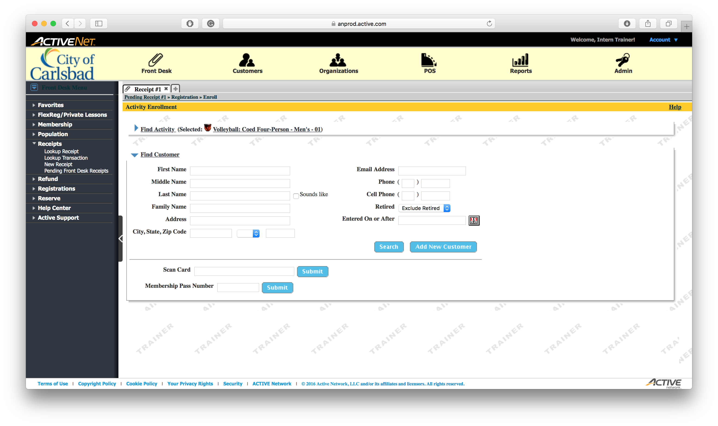
Tip:
Enter the First Name of the client

Slide 9

Tip:
Enter the Last Name of the client

Slide 10

Tip:
STOP: Notice the red light? Click to learn more.
Click Search to search for the client

Slide 11
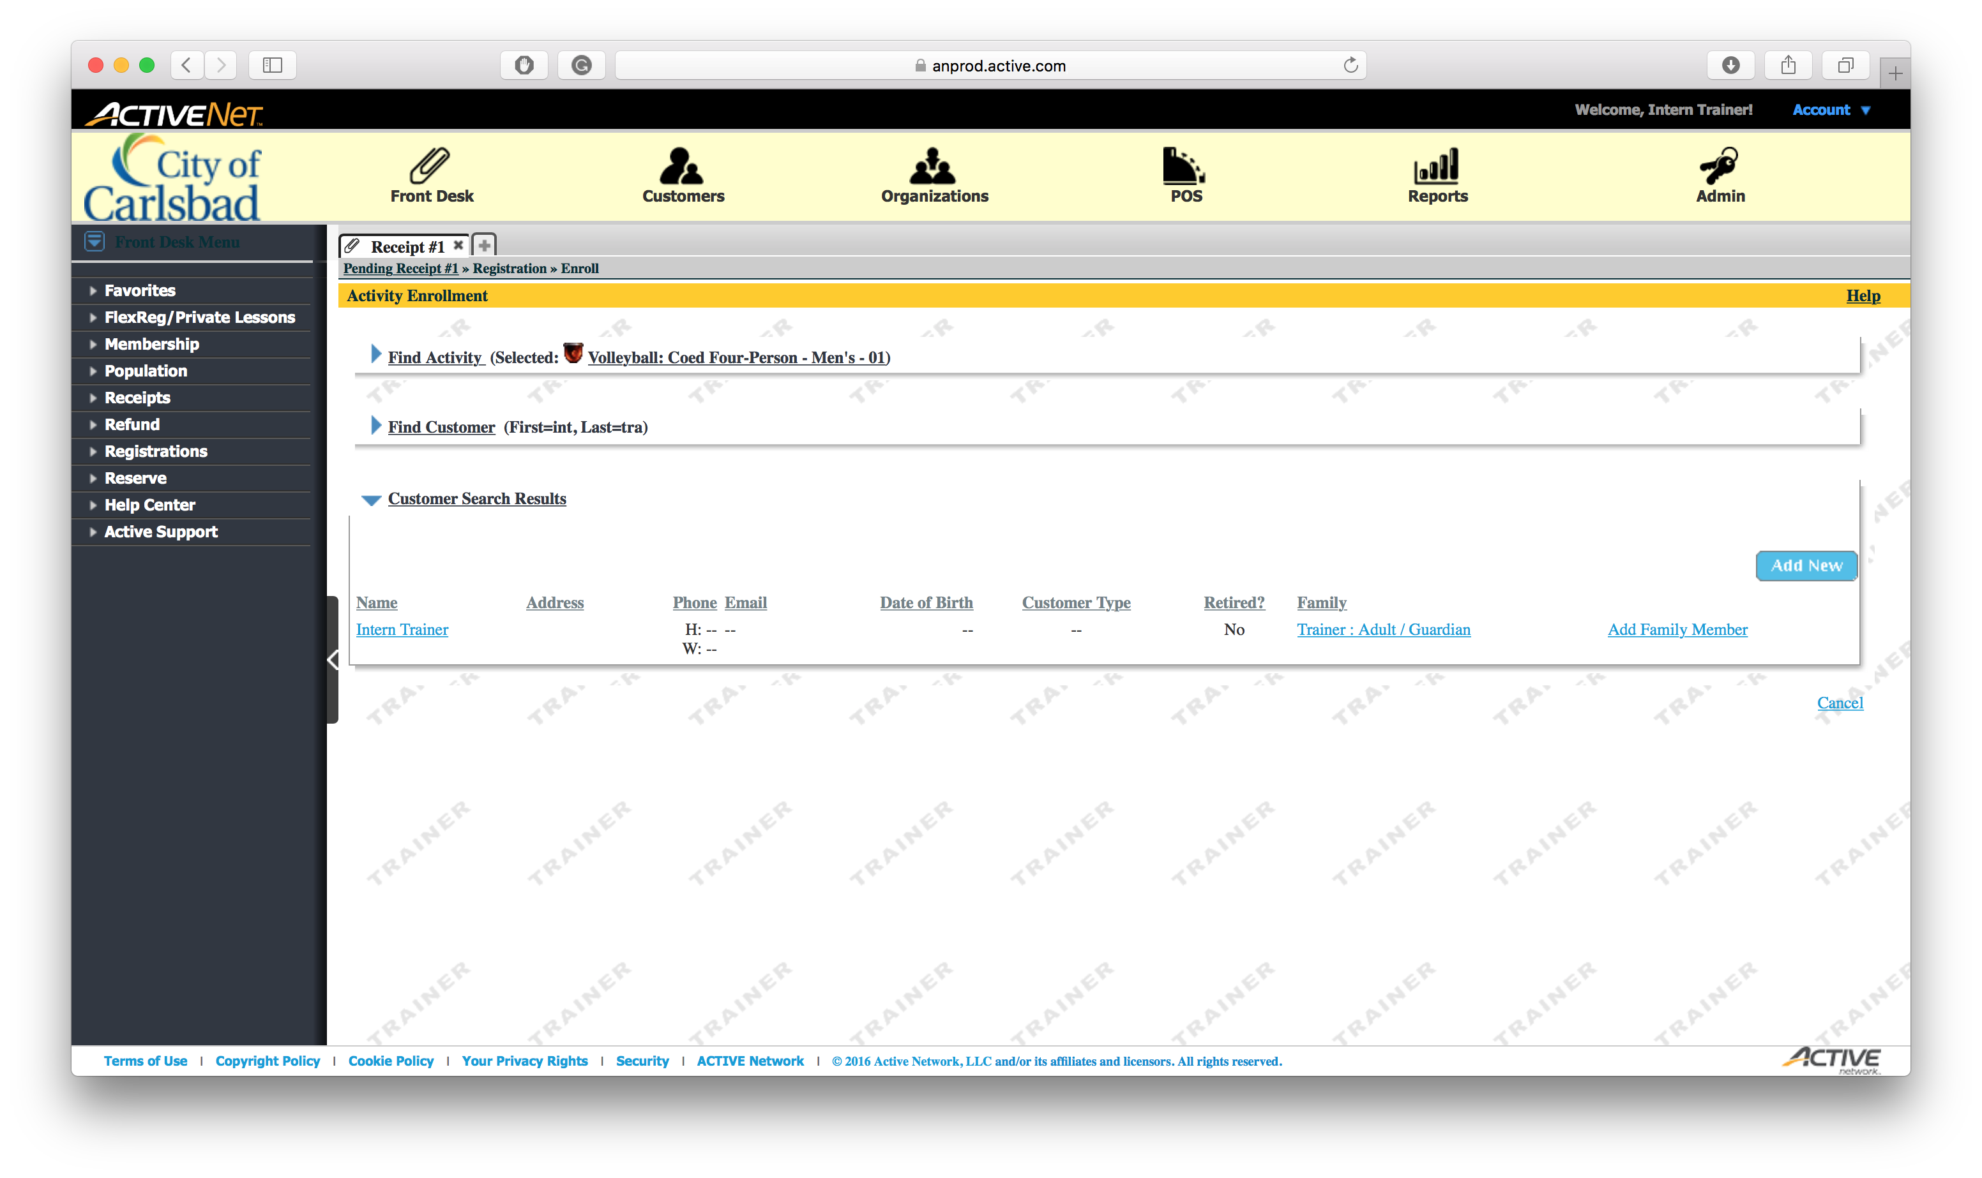
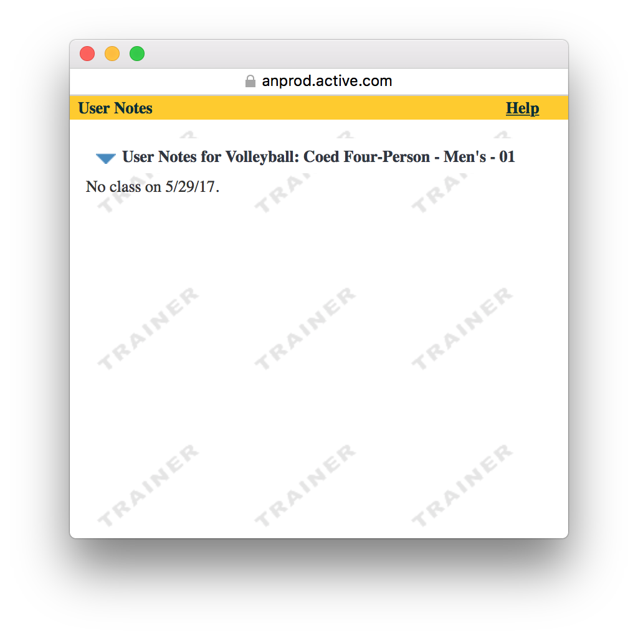
Tip:
After confirming the message, close the window

Slide 12
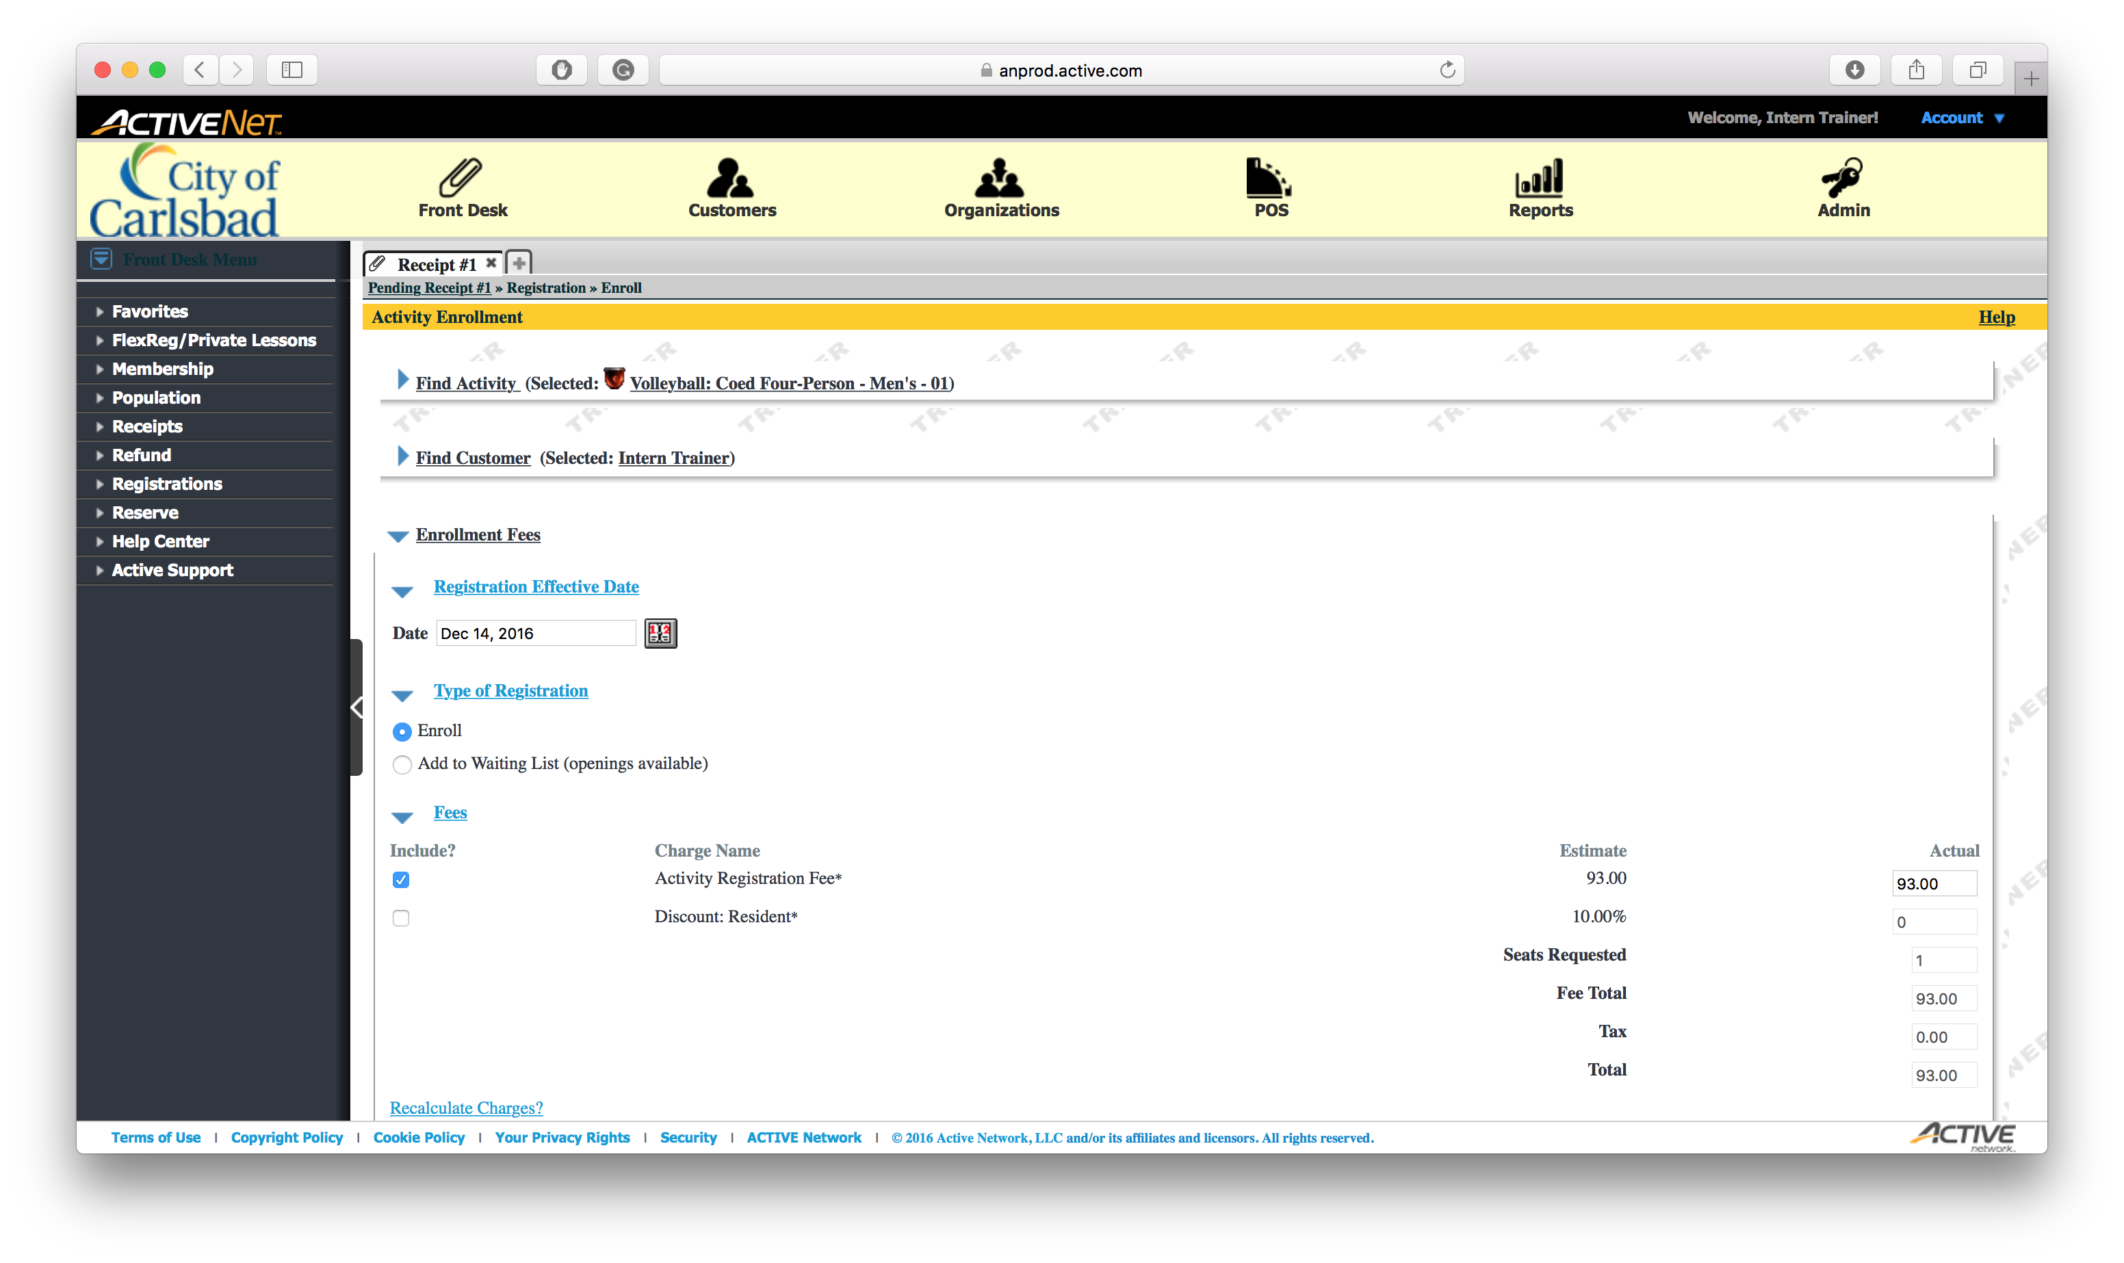
Tip:
Click the tab header to scroll down
Normally, you can just scroll down – minimizing the section is optional.

Slide 13
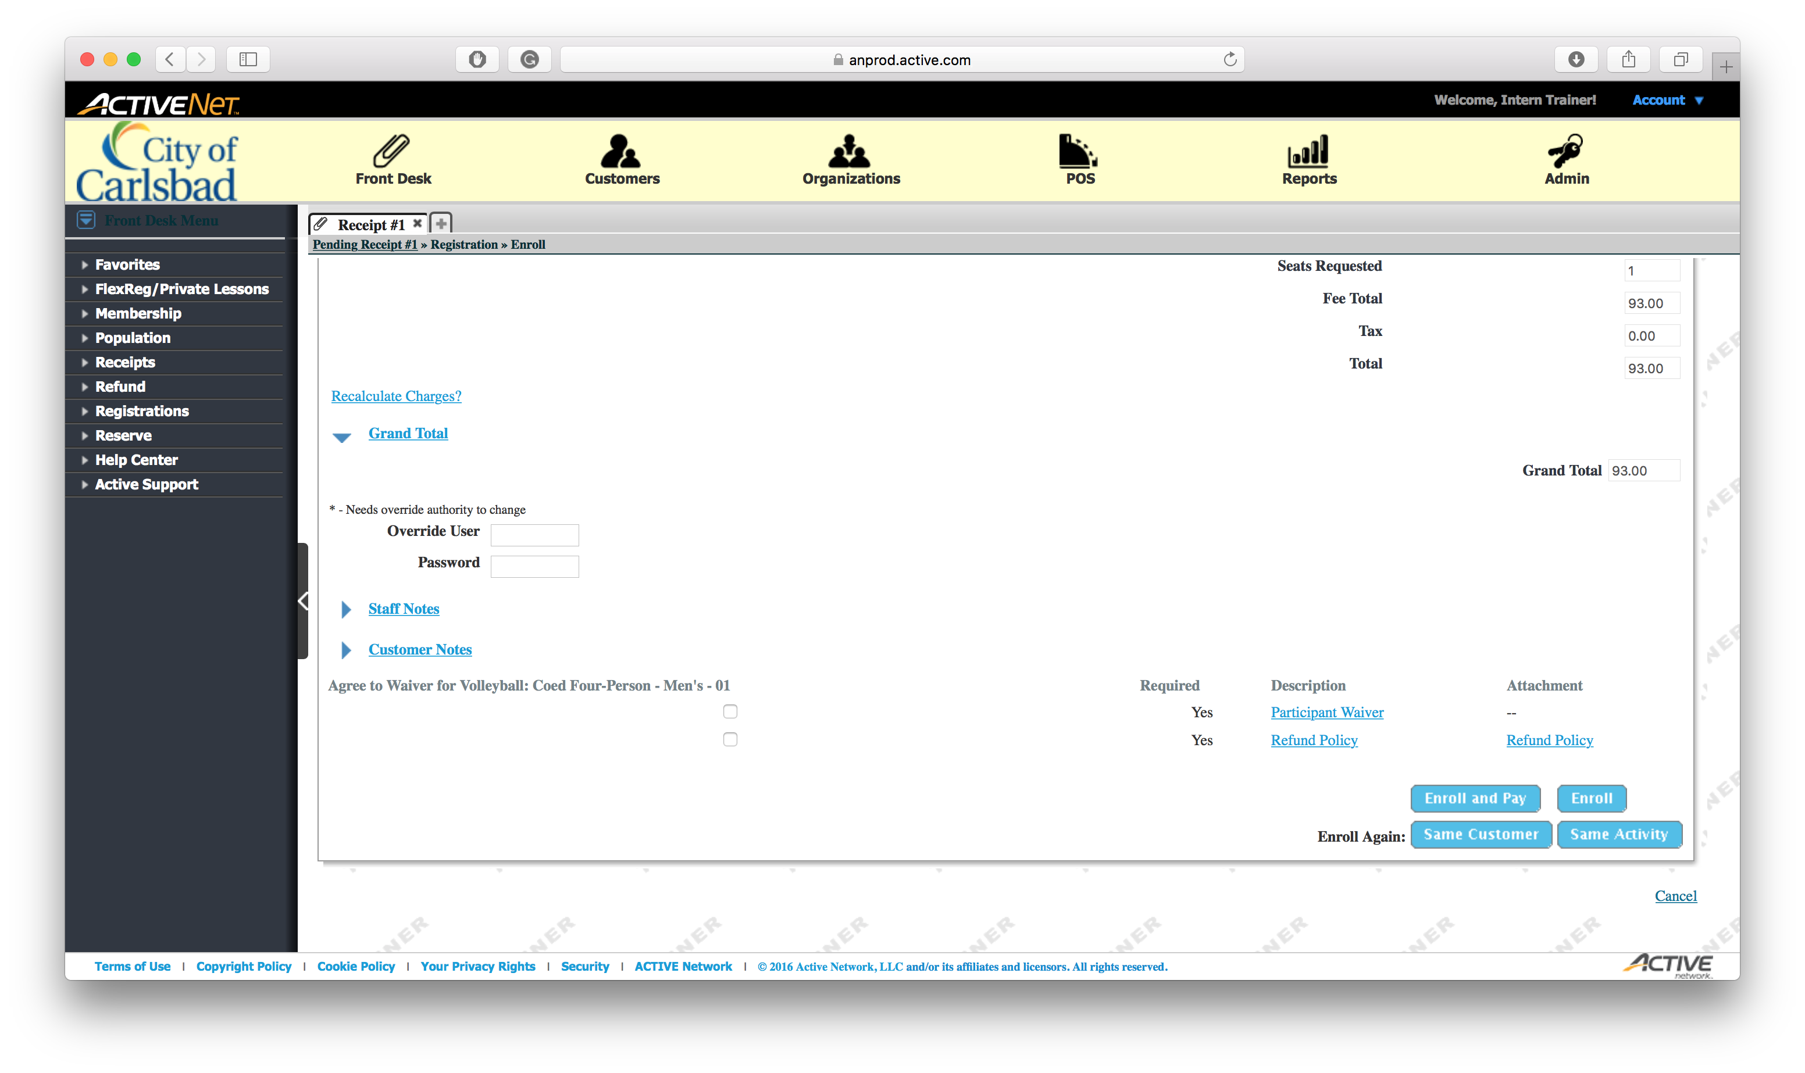
Tip:
Click the checkbox to verify the client agrees with the Participant waiver.

Slide 14

Tip:
Click to verify the client agrees with the
Refund Policy.

Slide 15
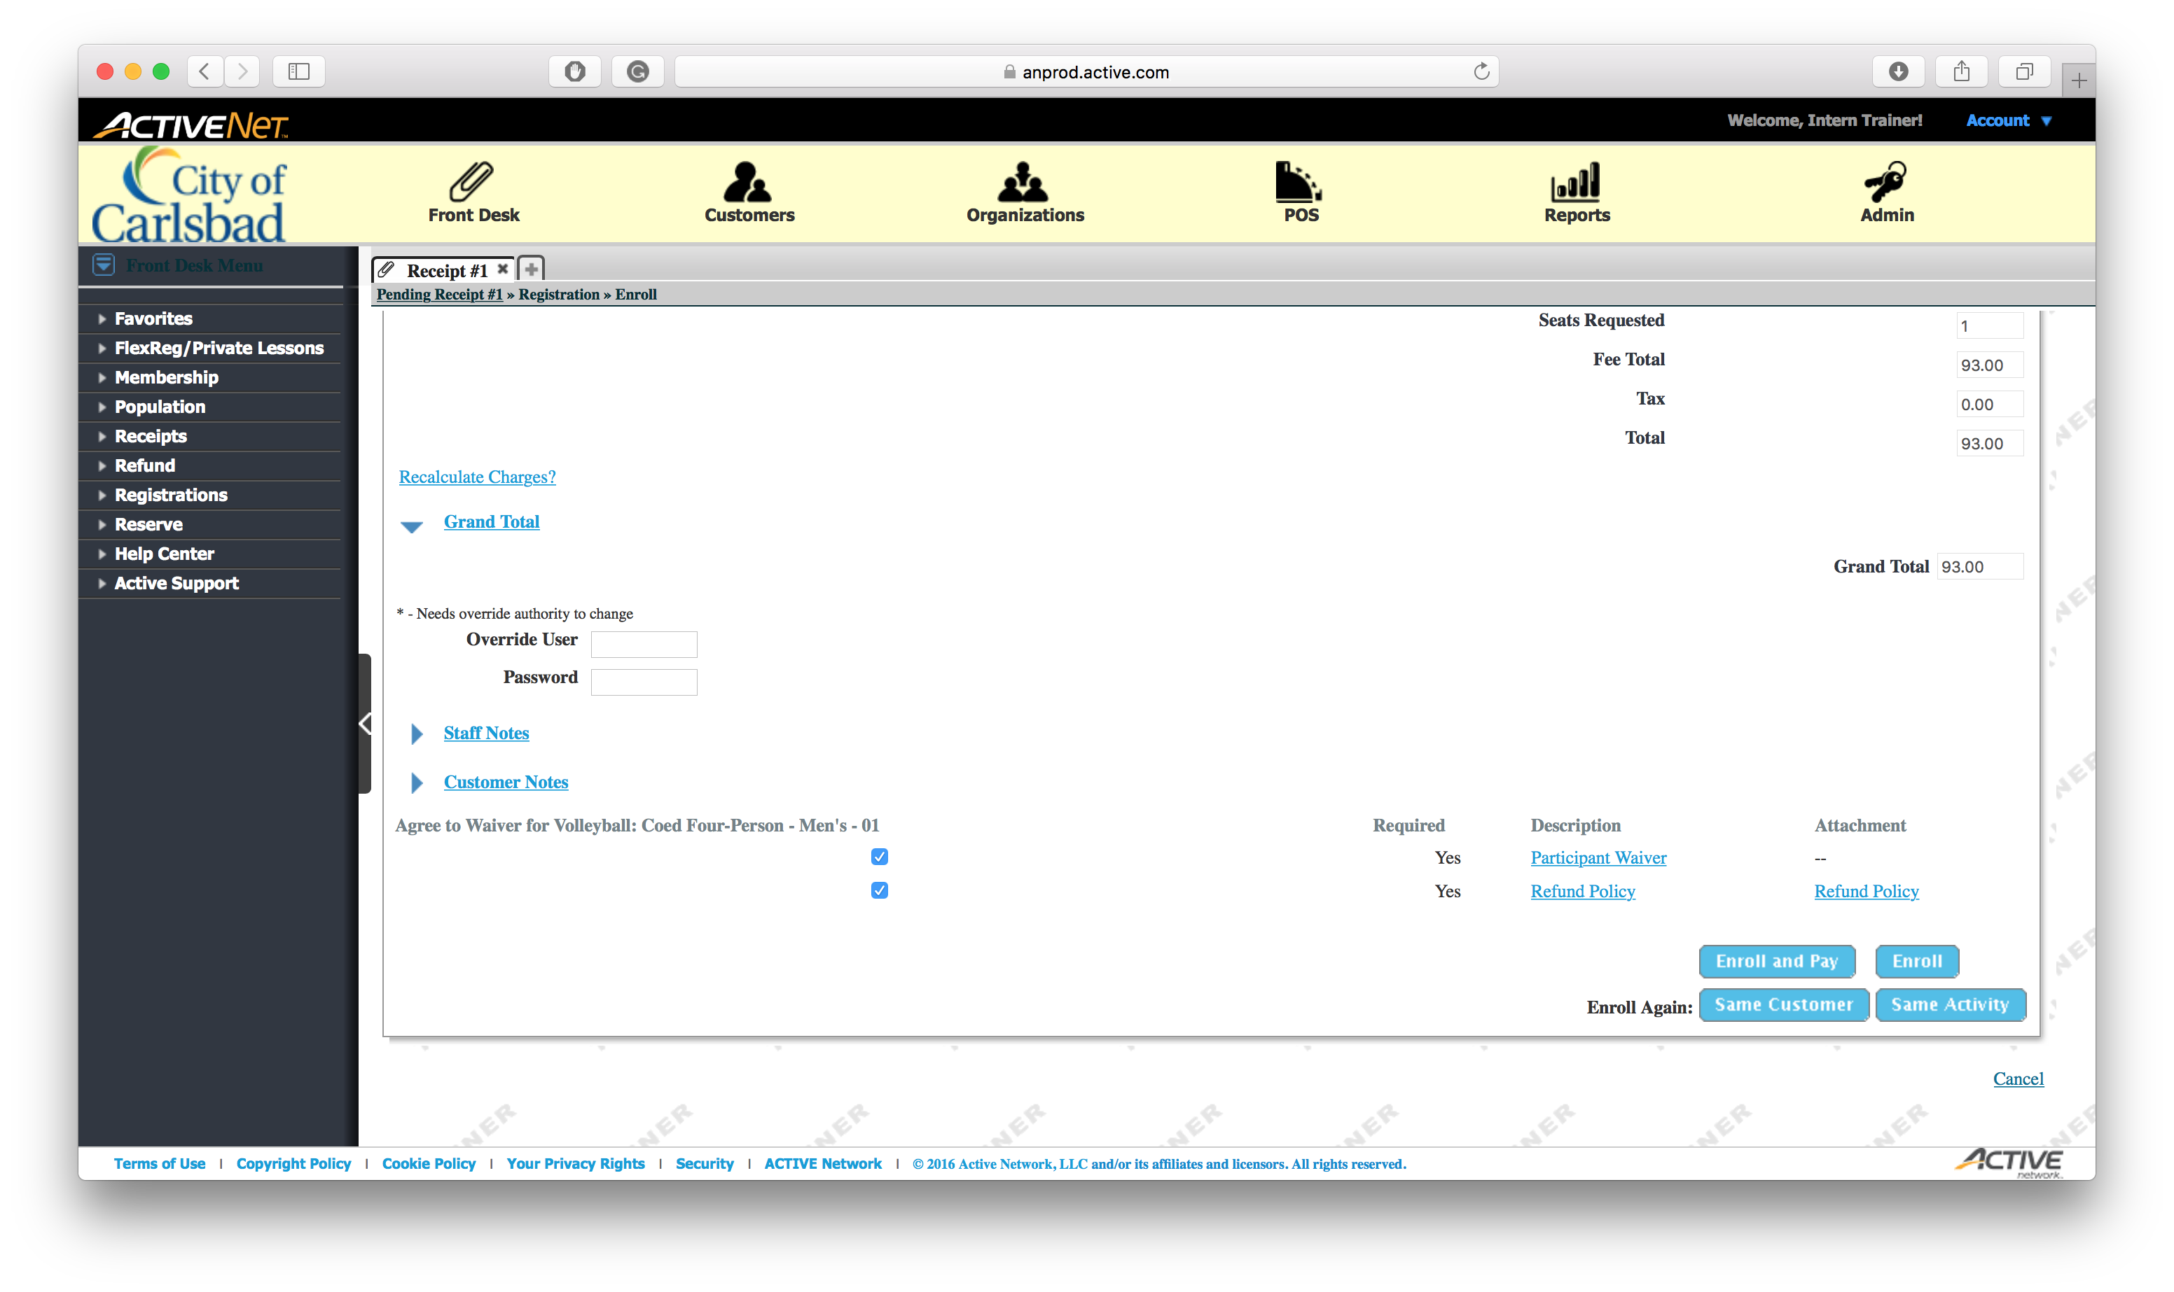
Tip:
NOTE: if you wish to view the policies, to read to the client, click the respective links.
If they already know them, select Enroll and Pay.

Slide 16
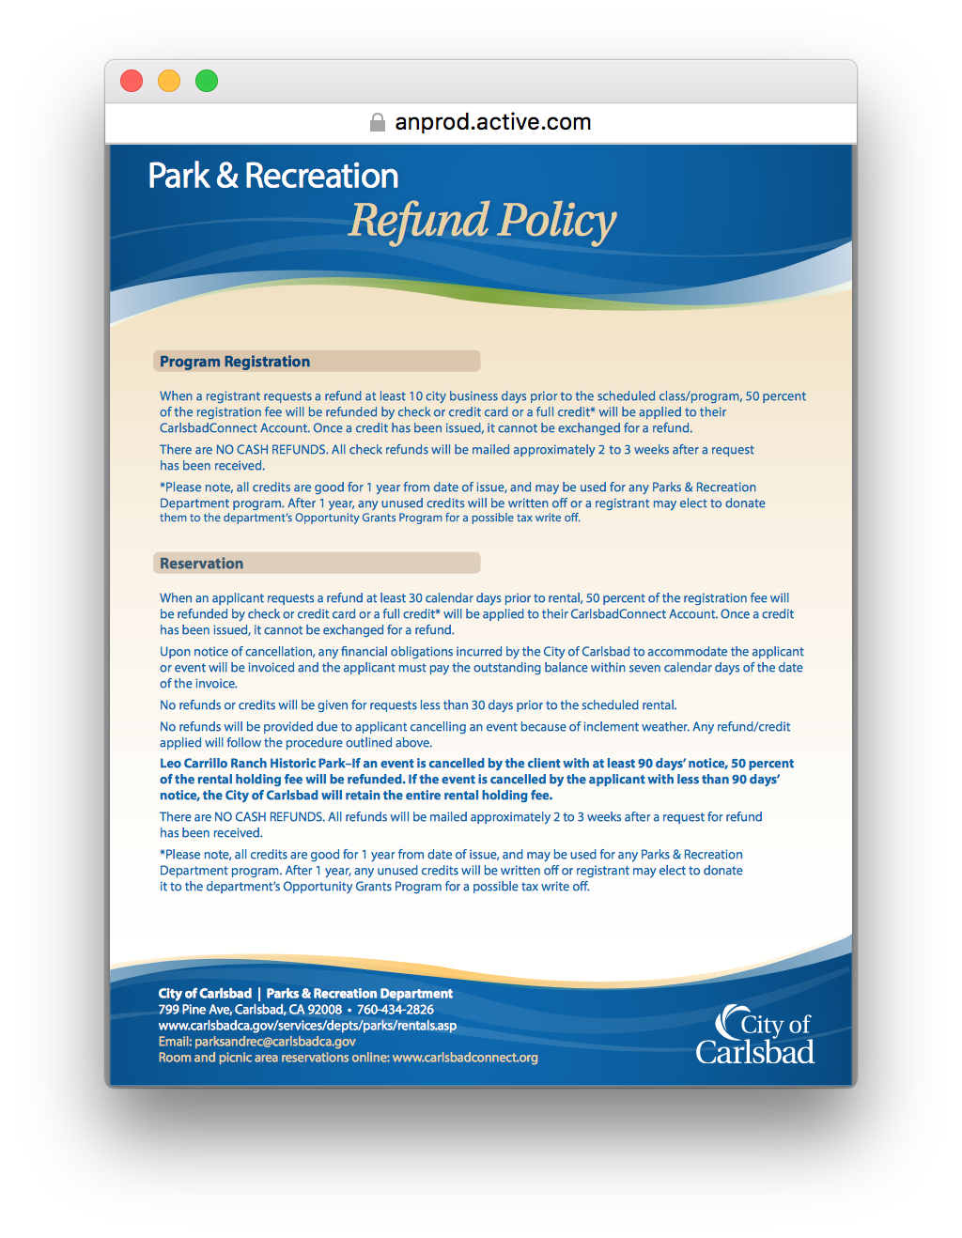
Tip:
Understand the policy, then close the window

Slide 17
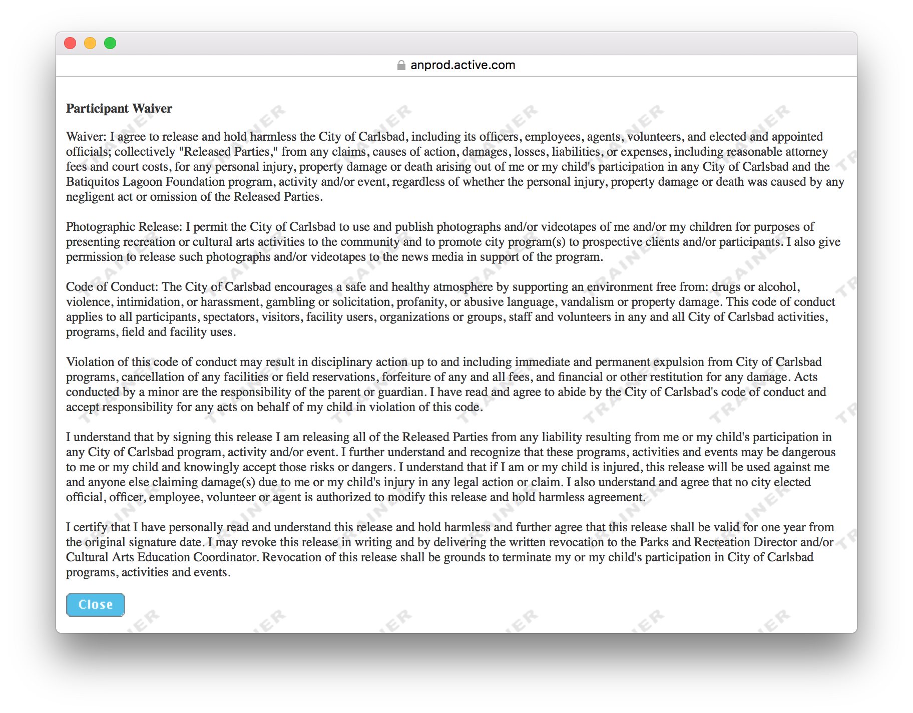
Tip:
Understand the waiver, then close the window

Slide 18
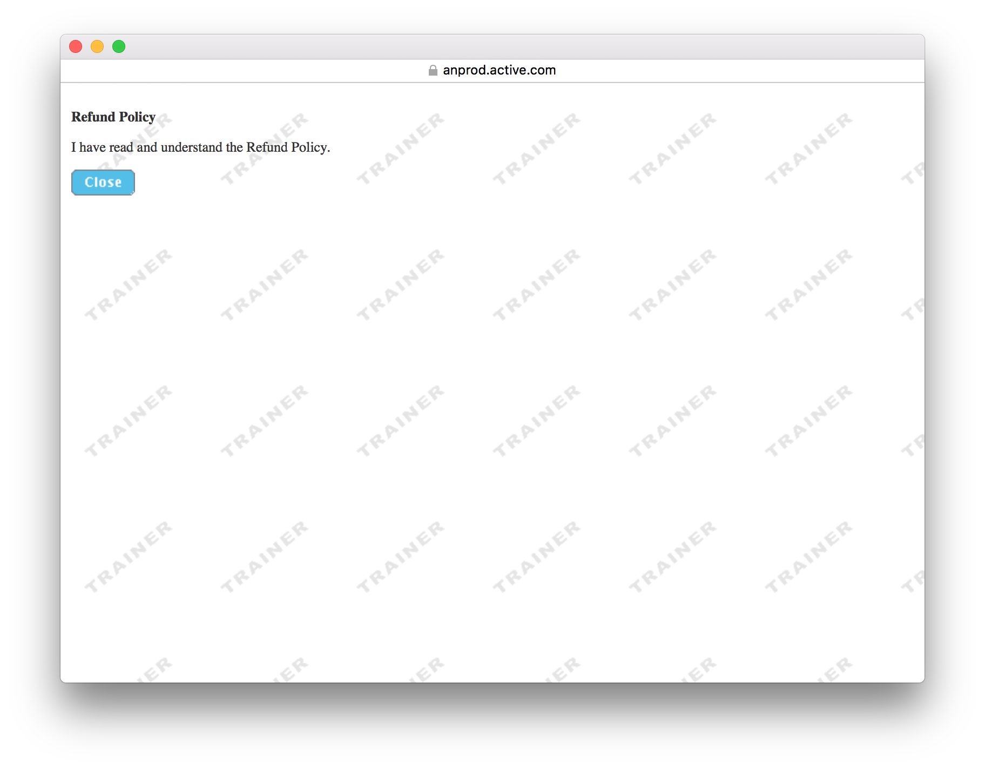
Tip:
This statement is noting that the client agrees to the waiver.

Slide 19

Tip:
Click Select to use the existing client as the payer.

Slide 20
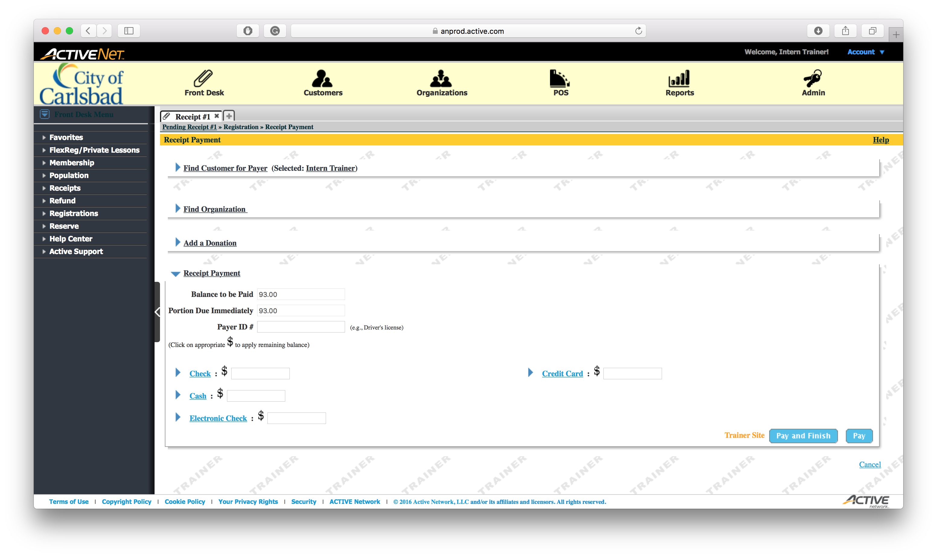
Tip:
Click the $ to auto-apply the balance.

Slide 21

Tip:
Click Pay and Finish

Slide 22
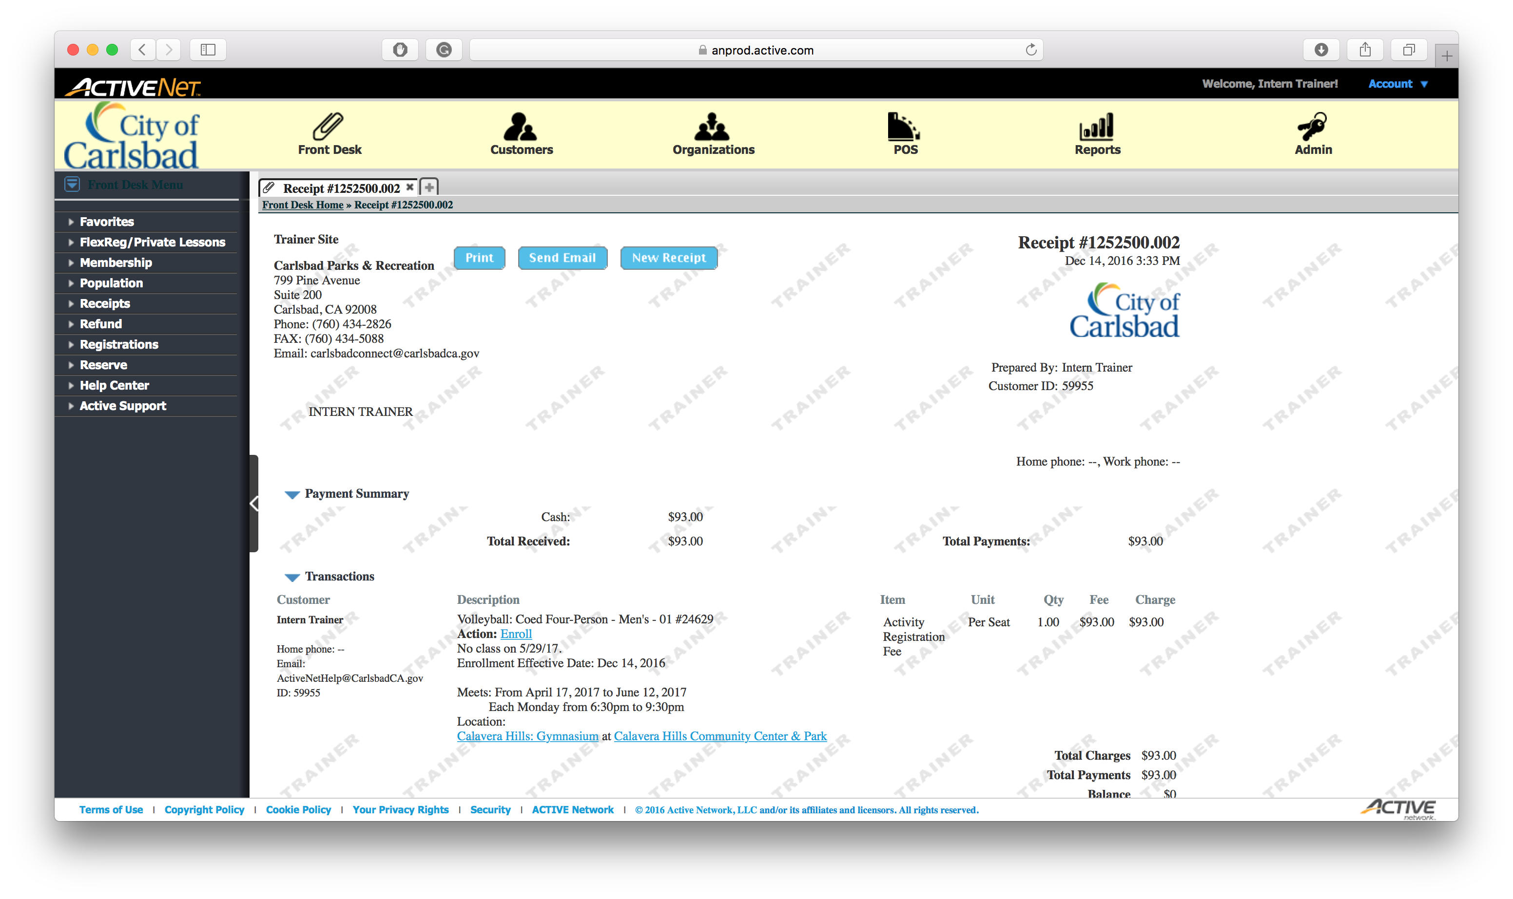
Tip:
Send and Email Receipt to the client if requested.

Slide 23
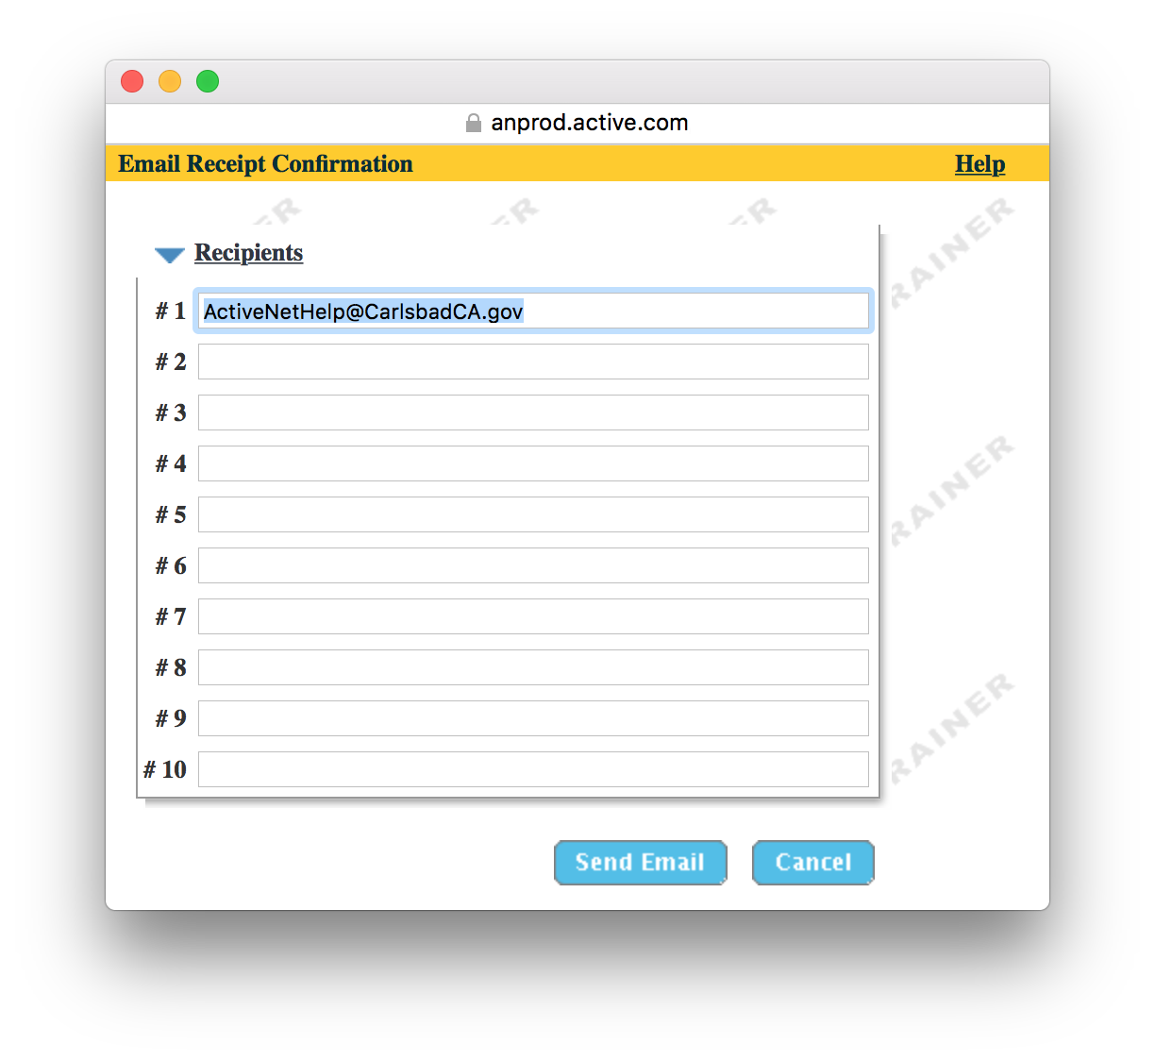
Tip:
Verify the email, then send.

